Slide 1
Kubernetes + Terraform + Vault + Consul

Slide 2

Service Discovery
How do we know where services are running?
How can consumers bind to services?
Hosts
Ports
What about using meta-data for service discovery?

Slide 3

Microservices
Service Discovery is particularly important
Large number of services
Service coordination based on availability
Active/active
Active/passive
Partitioning into read/write instances
Service versioning
Topology changes based on availability and deployment
Ephemeral infrastructure
EC2, PaaS, Docker etc…

Slide 4

Familiar Examples
DNS – internet scale service discovery
But not dynamic enough
Unix /etc/services
SOA with service catalogue/repository
Not usually runtime
Strong consistency requirements as found in distributed file systems and lock servers – e.g. leader election

Slide 5

Lock-Servers: Chubby
Google Chubby – Mike Burrows, 2006
Distributed lock server
“Allow clients to synchronize their activities & agree on basic
information about their environment”
Leader election
Allow leader to discover its servers
Allow clients to discover the leader
Meta-data storage – well-known & available location
Never released outside Google
http://static.googleusercontent.com/media/research.google.com/en//ar
chive/chubby-osdi06.pdf

Slide 6

Lock-Servers: Apache Zookeeper
Developed by Yahoo! & donated to Apache Foundation.
The de facto lock server in use today
Uses the Paxos algorithm
Guarantees strict ordering of events
…but difficult to setup and use.

Slide 7

The New Kids…
Doozerd – “consistent distributed data store”
inactive
etcd – “a highly-available key value store for shared configuration and service discovery”
Sponsored by CoreOS – very active
Consul – “a tool for service discovery, monitoring and
configuration”
Sponsored by Hashicorp – very active
All based on the Raft protocol for distributed consensus.

Slide 8

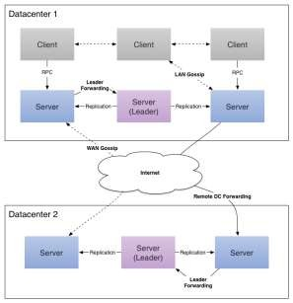
What’s Different about Consul?
More than a data store…
Has opinionated features and abstractions for
Service discovery
Monitoring
Consul agents run as a server or a client:
servers participate in the Raft quorum to
maintain cluster state
Clients proxy requests to servers
support more sophisticated health checks
Is datacentre aware
Provides HTTP and DNS interfaces

Slide 9

Health Checks
Script + Interval
Runs a script on a given interval
Exit status: 0=healthy, 1=warning, other=failed
TTL – like a dead-man switch
Application reports its status periodically
No report -> failed status

Slide 10

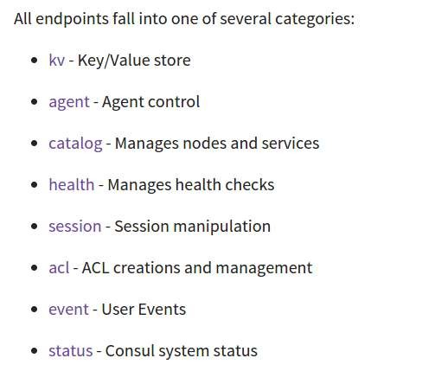
HTTP API

Slide 11


Consul & Docker
progrium/consul
Preconfigured consul agent designed to run in docker
progrium/registrator
Uses docker events & config to automatically register docker
containers into Consul (& etcd & SkyDNS)

Slide 12
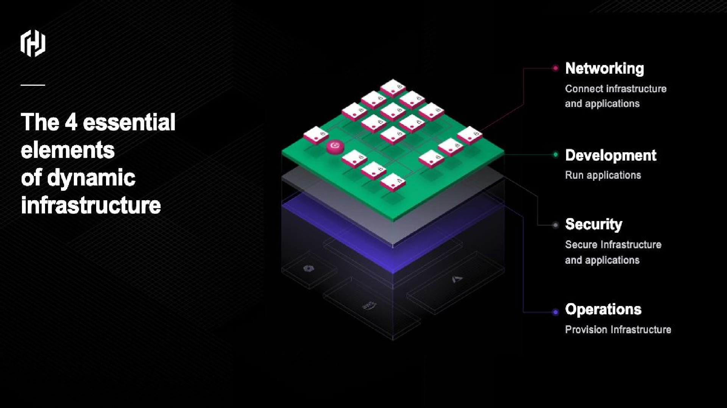

Slide 13
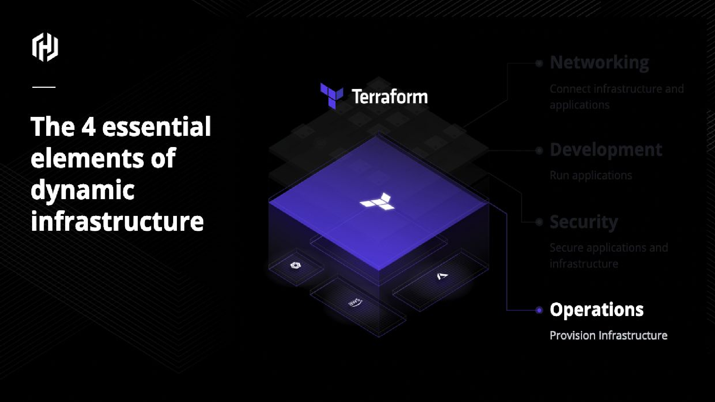

Slide 14
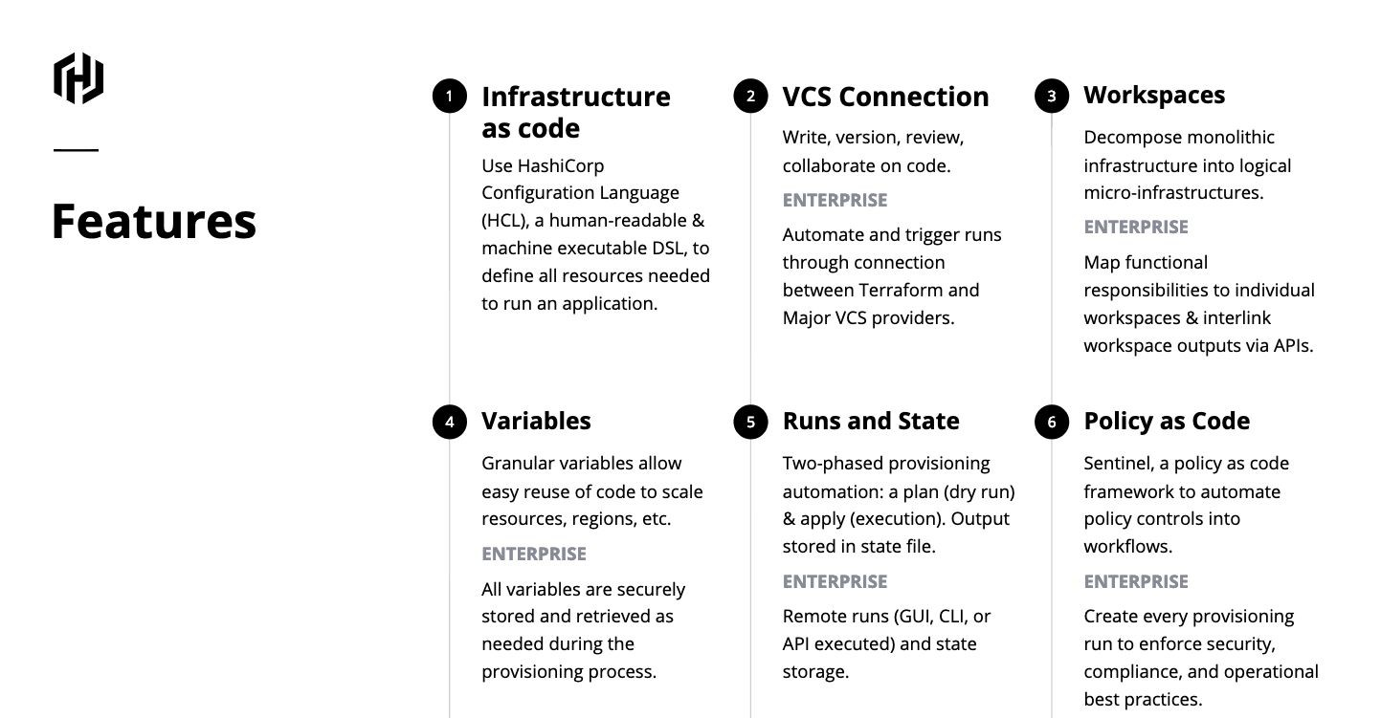
Overview - Terraform

Slide 15
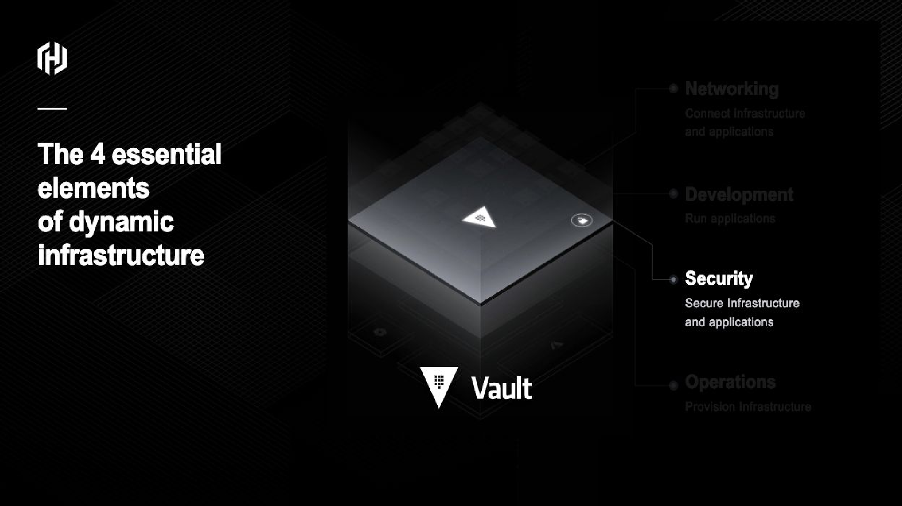

Slide 16
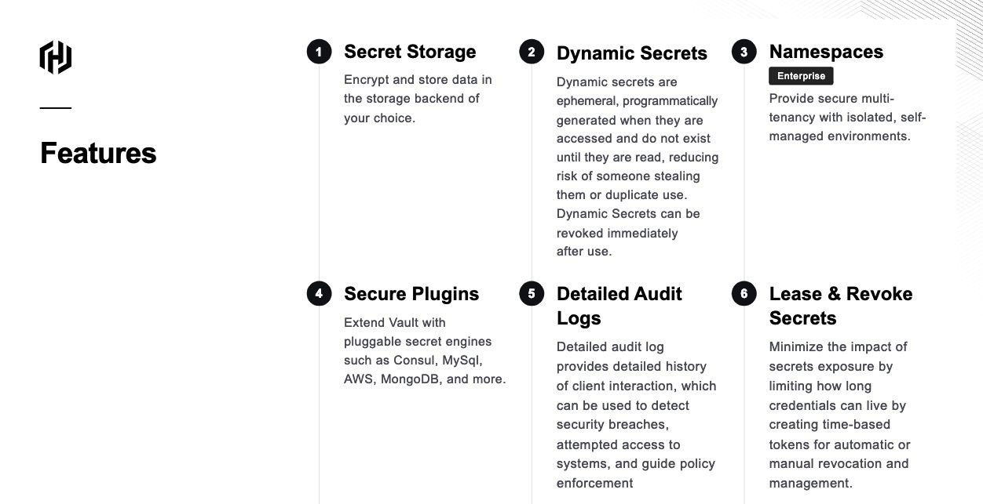
Overview - Vault

Slide 17
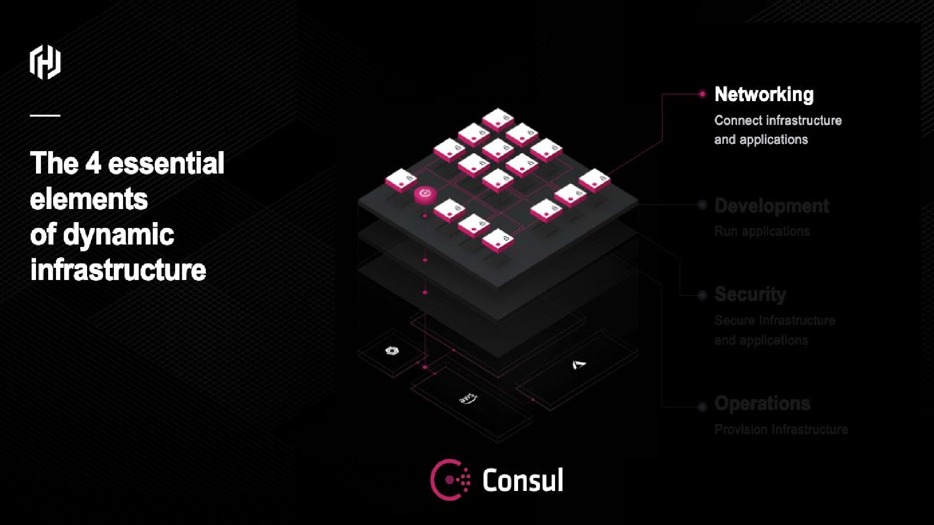

Slide 18
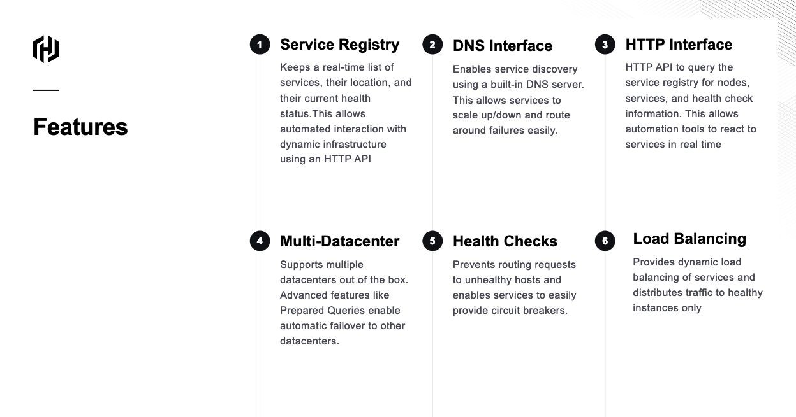
Overview - Vault

Slide 19
Consul VS Istio
ISTIO
Istio provides layer 7 features for path-based routing, traffic shaping, load balancing, and telemetry.
Agentless
Complex (Lots of moving parts - GKE simple install)
Consul
Consul enforces authorization and identity to layer 4 only -- either the TLS connection can be established or it can't.
Agent Based
Low Complexity

Slide 20
Vault on Kubernetes
Vault HA - The Vault cluster is deployed in HA mode backed by Consul
Auto-Init and Unseal - Vault is automatically initialized and unsealed at runtime. The unseal keys are encrypted with Google Cloud KMS and stored in Google Cloud Storage
Vault supports opt-in automatic unsealing via cloud technologies: AliCloud KMS, Amazon KMS, Azure Key Vault, and Google Cloud KMS.
Full Isolation - The Vault cluster is provisioned in it's own Kubernetes cluster
Audit Logging - Audit logging to Stackdriver can be optionally enabled with minimal additional configuration.

Slide 21
Vault Auto Unseal - Init
The vault-init service automates the process of initializing and unsealing HashiCorp Vault instances running on Google Cloud Platform.
After vault-init initializes a Vault server it stores master keys and root tokens, encrypted using Google Cloud KMS, to a user defined Google Cloud Storage bucket.
Usage
The vault-init service is designed to be run alongside a Vault server and communicate over local host.
Configuration
The vault-init service supports the following environment variables for configuration:
CHECK_INTERVAL - The time in seconds between Vault health checks. (300)
GCS_BUCKET_NAME - The Google Cloud Storage Bucket where the vault master key and root token is stored. KMS_KEY_ID - The Google Cloud KMS key ID used to encrypt and decrypt the vault master key and root token.

Slide 22
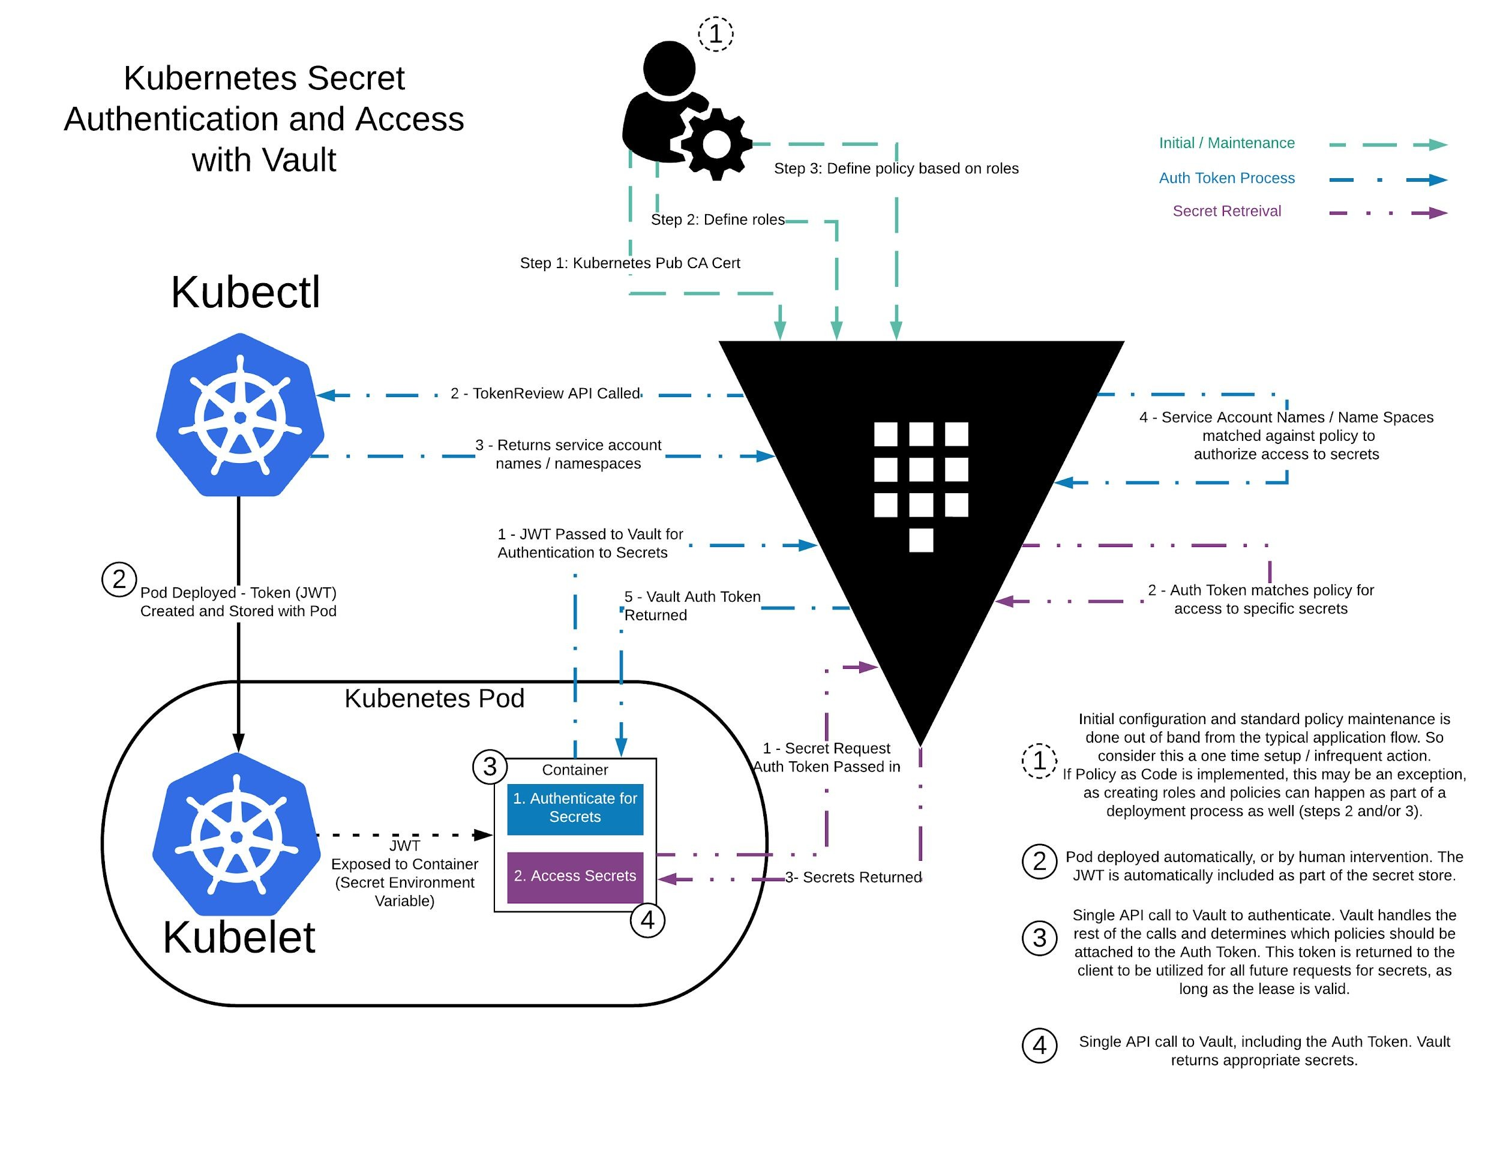
Vault Auth Kubernetes

Slide 23
Benefits of Cloud KMS
Cloud KMS is a cloud-hosted key management service that lets you manage cryptographic keys for your cloud services.
Set keys to automatically rotate regularly
Manage Cloud IAM permissions for user-level permissions on individual keys and grant access to both individual users and service accounts.
Help satisfy compliance needs
Cloud KMS has a built-in 24-hour delay for key material destruction, to prevent accidental or malicious data loss.

Slide 24
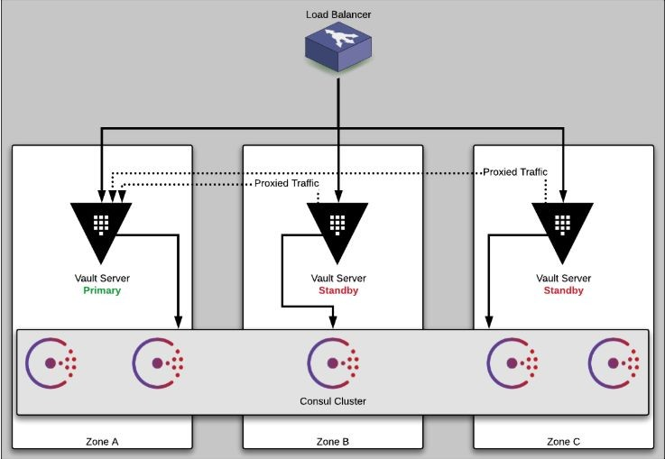
Overview - Architecture

